Slide 1
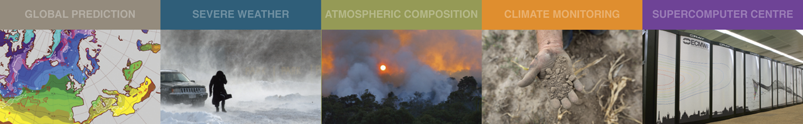
ECMWF Status Report (1)
GODEX 2017
Lars Isaksen and Ioannis Mallas
ECMWF
Lars.Isaksen@ecmwf.int
Ioannis.Mallas@ecmwf.int
Acknowledgements to: Patricia de Rosnay, Enrico Fucile, Stephen English, Bruce Ingleby, Cristiano Zanna, Niels Bormann, Philippe Chambon, Katrin Lonitz, Peter Lean, Heather Lawrence, Cristina Lupu

Slide 2
Outline
Change in use of observations and DA since October 2015 – Lars Isaksen
Observation usage summary
Events October 2015 – April 2017
IFS cycle updates in 2016-2017, and planned for later in 2017
Some future plans
This afternoon:
BUFR migration, timeliness and snow data issues – Ioannis Mallas

Slide 3
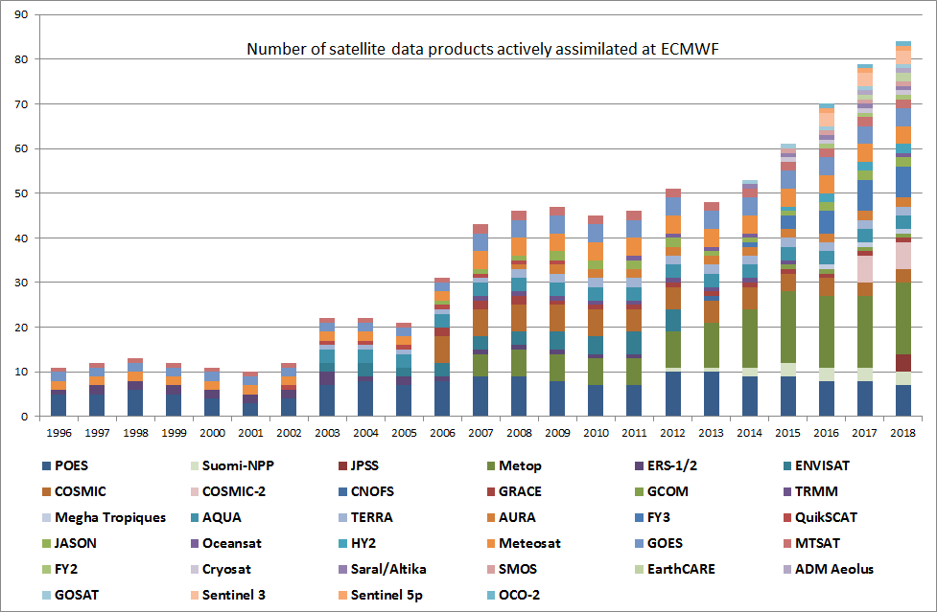
Satellite observations 1996-2015: projected to 2018
Number of
satellite products
operationally
monitored

Slide 4
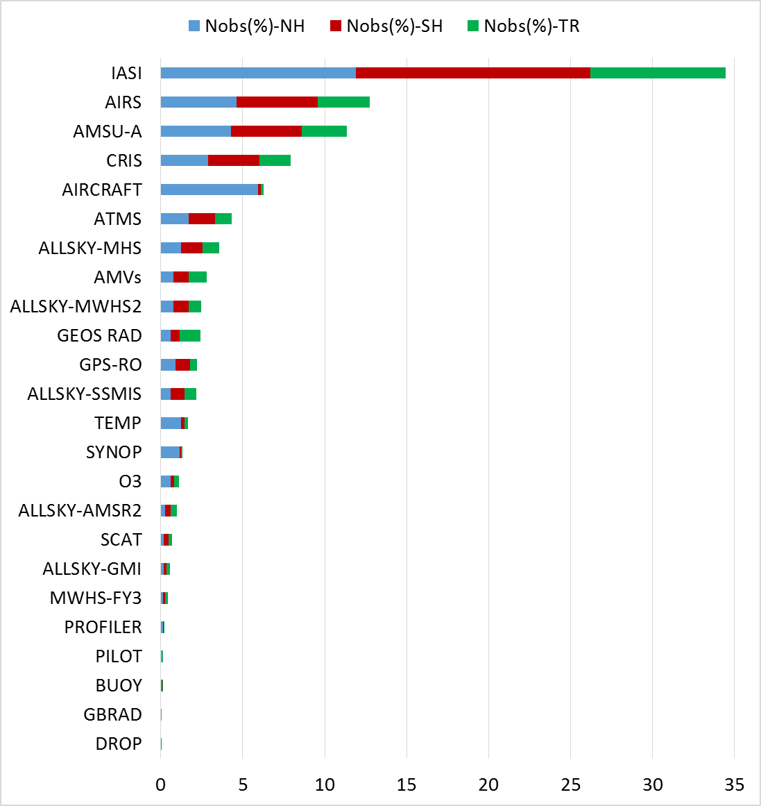
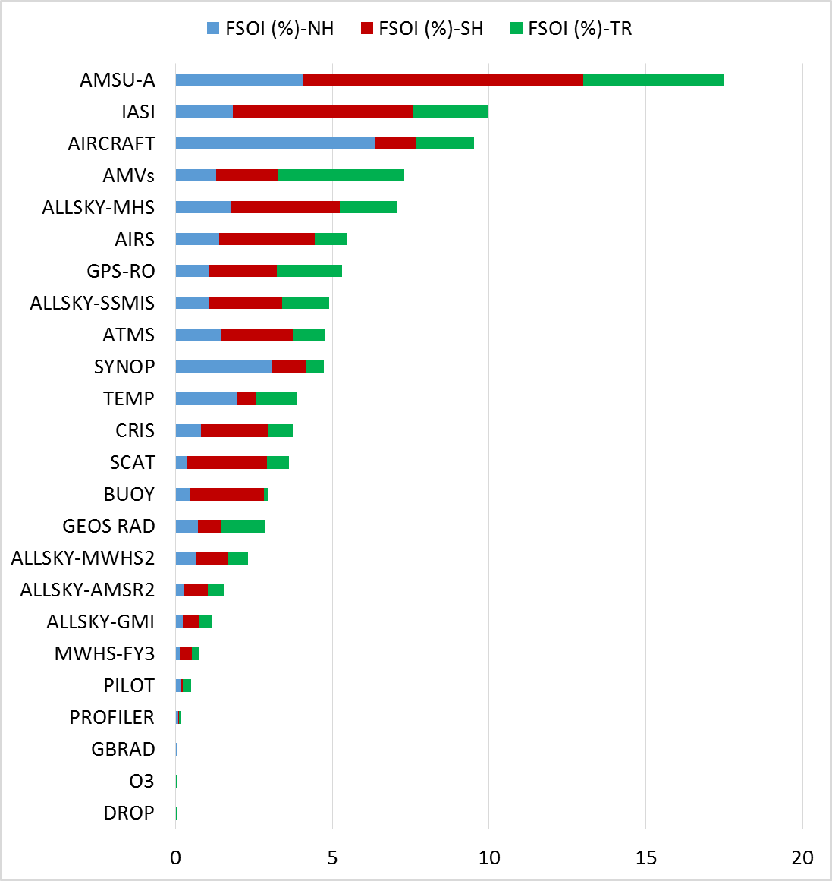
Nobs and total FSOI by instrument: NH, SH, TR
May – August 2016

Slide 5
Key data events Oct 2015 – August 2016
Month | Data in | Data out | System
October 2015 |  | Blacklist NOAA-18(ch 5), AIRS (ch 221), IASI(ch 271,272,273), CrIS(ch 101)
November 2015 | METOP-B/IASI noise decrease, due to ice decontamination
December 2015
January 2016 | HIMAWARI-8 CSR activated. NOAA-18 Channel 5 and 8 activated | MTSAT-2 CSR blacklisting
February 2016 | AMVs from METOP-A&B and dual METOP-A&B activated. Aircraft humidity activated. Additional AMDAR over Atlantic and Africa.
March 2016 | HIMAWARI-8 AMV activated. BUFR SYNOP France activated | METOP-A/HIRS blacklisted. MTSAT-2 AMVs blacklisted | CY41R2 TCo1279 operational
April 2016 | FY-3C/MWHS-2 activated. | OSTIA sea ice problems
May 2016 | BUFR radiosonde block 16 and 94 activated.
June 2016
July 2016 | BUFR buoy data activated.
August 2016 | VIIRS/AMVs activated

Slide 6
Key data events September 2016 – April 2017
Month | Data in | Data out | System
September 2016
October 2016 |  | Rejection of TC dropsondes from reconnaissance flights and near eye-wall. Blacklist of channels 5-8 from Metop-B/AMSUA due to the failure of channel 15.
November 2016 | Significant increase of AMDAR data over South America. Activation of BUFR PILOT | End of ISS/Rapidscat mission. | Wave Optics processor for GRAS implemented CY43R1 operational
December 2016 | Activation of Metop-B/AMSUA channels 5-8. This was done after a modification by the observation team to set channel 15 to missing. Activation of Jason-2 wave height.
January 2017 | Activate AQUA/AMSUA.
February 2017 | Activated BUFR radiosondes for many WMO blocks: 07, 16 and 85.
March 2017 | Activation of MET-8 data (AMV and ASR) . Change of ACARS encoding format to WIGOS AMDAR. Activation of ATMS. | Blacklisting of MET-7
April 2017 |  | EARS NOAA-15/AMSUA stopped being produced. | July 2017: CY43R3 planned operational

Slide 7
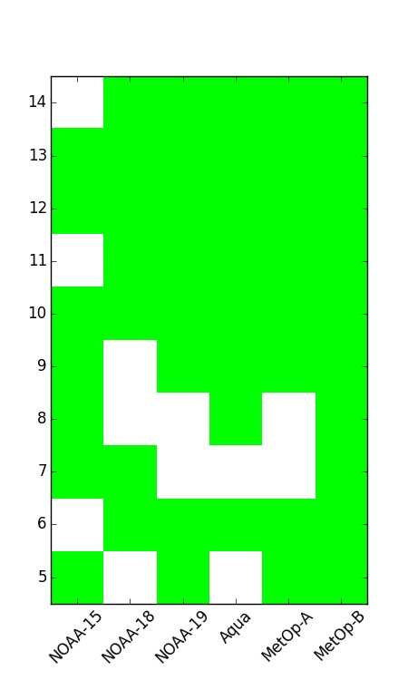
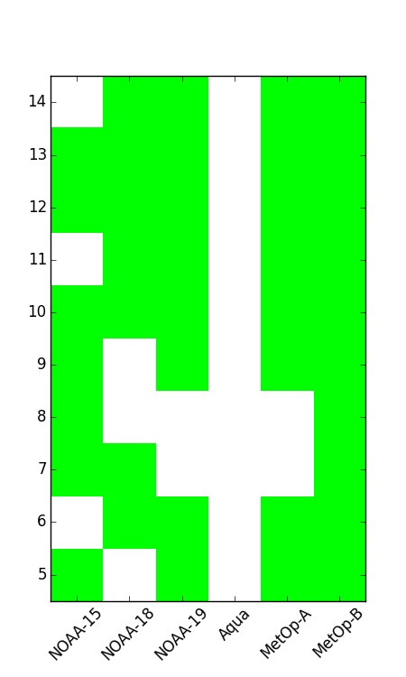
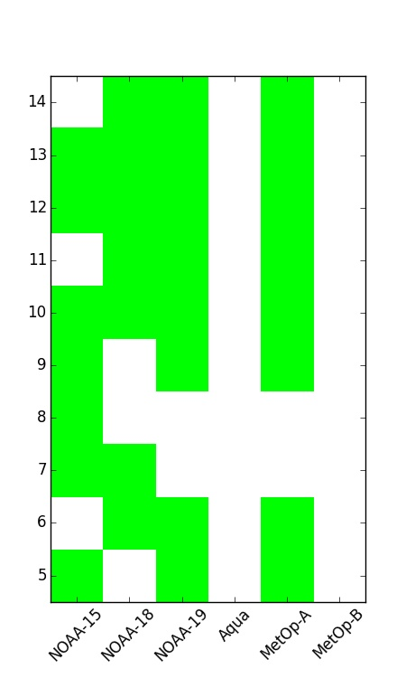
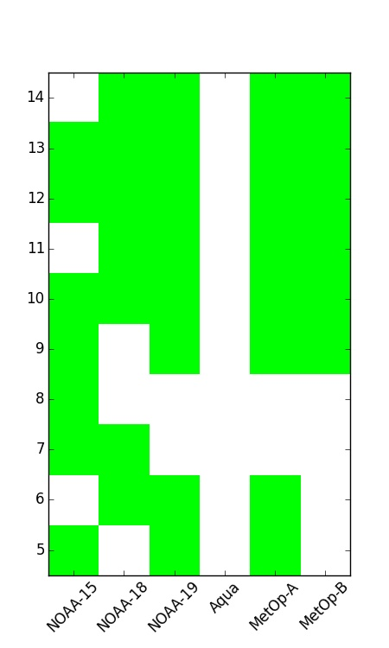
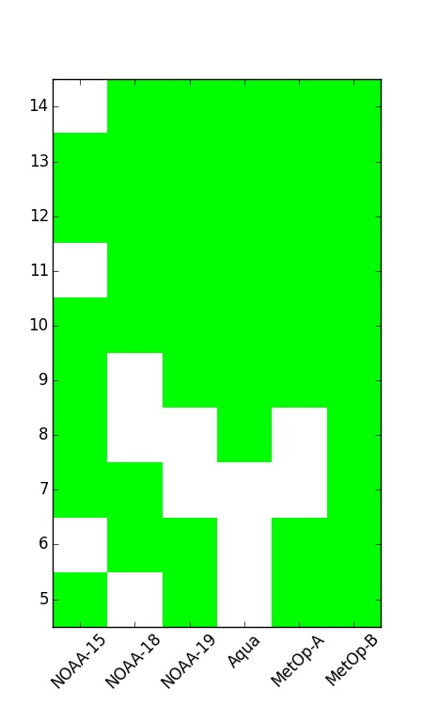
AMSU-A data events: September 2016 to January 2017
Pre 23rd Sept 2016
24 Sept 2016: Loss of Aqua AMSU-A due to failure of channels 1 & 2
17 Oct 2016: Loss of MetOp-B AMSU-A due to failure of channel 15
29 Nov 2016: Reactivation of MetOp-B AMSU-A channels 9 to 14 thanks to code change to relax pre-screening check and remove QC dependencies on channel 15
15 Dec 2016: Reactivation of MetOp-B AMSU-A channels 5 to 8 (5 & 6 over sea only)
12 Jan 2017: Reactivation of Aqua AMSU-A channels 8 to 14 thanks to code change to relax pre-screening check and remove QC dependencies on channels 1 & 2
AMSU-A channels assimilated by satellite
Tropospheric
channels

Slide 8
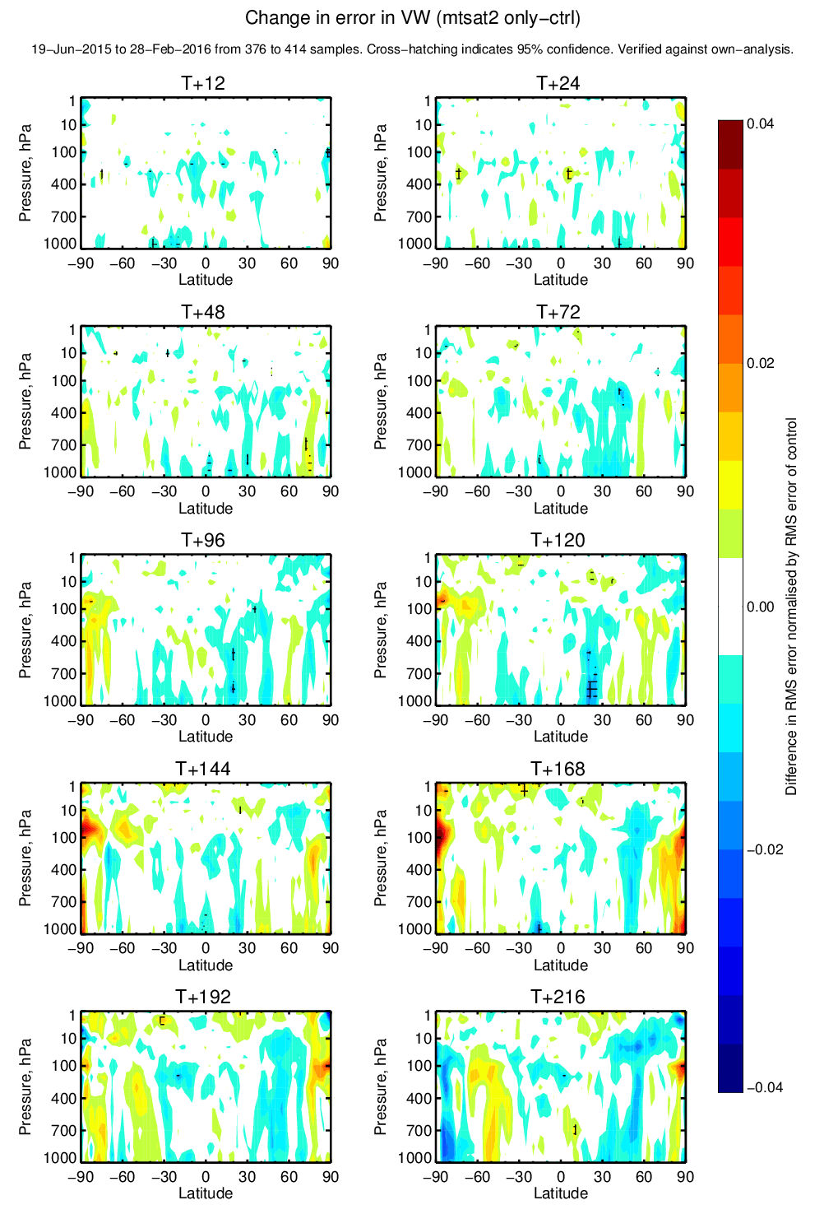
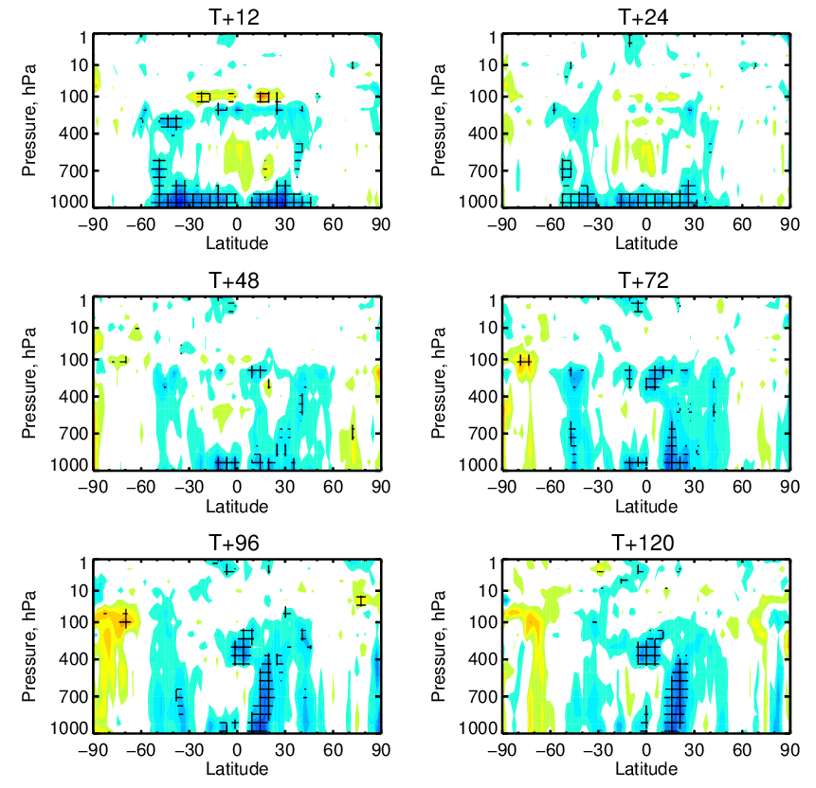
Positive impact of Himawari-8: change in error in vector wind
Control = no MTSAT-2
Himawari-8 vs. ctrl
MTSAT-2 vs. ctrl
Bad
Impact of Himawari-8 much more positive
Good
6 months (summer + winter)

Slide 9
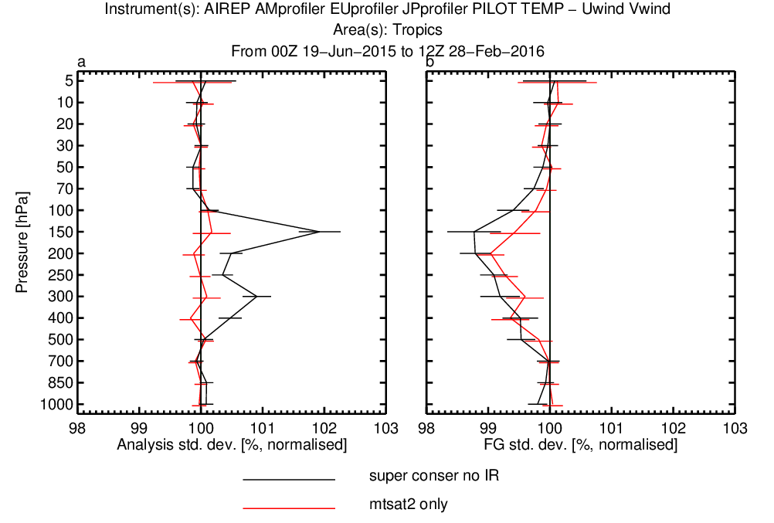
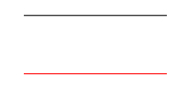
Improved fits of observations to model background
AIREP AMprofiler EUprofiler JPprofiler PILOT TEMP – U and V wind (tropics)
Using ~40% more AMVs at most pressure levels compared to MTSAT-2
Both have +ve impact for ATMS humidity channels
Good
Bad
AMVs became operational 15th March 2016
6 months (summer + winter)
Himawari-8
MTSAT-2

Slide 10
Cycle 41r2 (March 2016) - Highlights
MOD
TCo1279: new cubic-octahedral reduced Gaussian grid
Number of iterations in semi-Lagrangian trajectory
Radiation-surface LW/SW updating, radiation-surface LW tiling
Improved physics for freezing rain
TL/AD surface and VDF, non orographic drag
GPSRO observation error adjustment
Assimilation of aircraft humidity data
EDA resolution TCo639 fc/outer loop, TL191/T191 inner loops
Same hybrid B both in EDA and HRES
HRES-4DVAR inner loops: TL255/TL319/TL399
ENS resolution TCo639 to day 15; TCo319 to day 45.
OBS
DA
ENS
Notes:
Probabilities can be computed from ensemble members and should be available soon in eccharts (june)

Slide 11
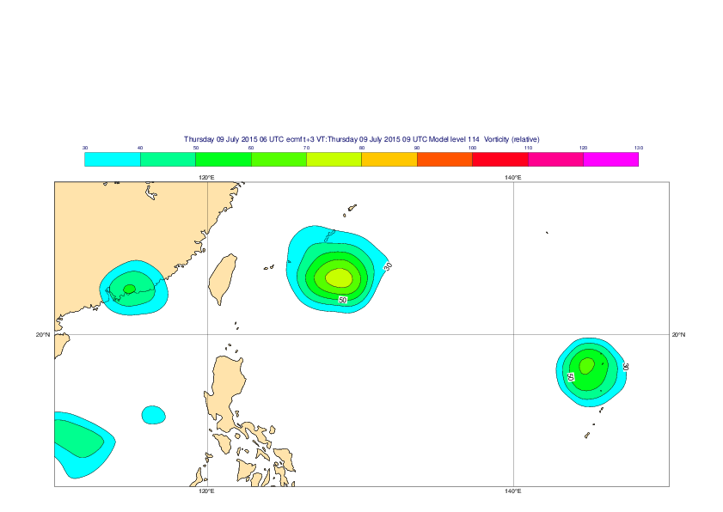
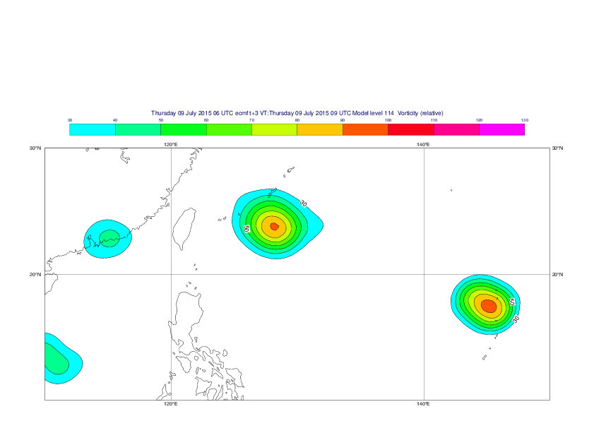
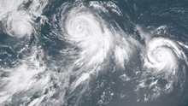
41r2: EDA improvements, TCo639 + B
Higher TCo639 resolution, smaller-scale variance and B heavily weighted towards the days errors at smaller scales gives more accurate analysis/forecasts and more spread where it matters.
41r1 TL399 20150709 0900z
41r2 TCo639 20150709 0900z
“Linfa, Chan-hom, and Nangka”

Slide 12
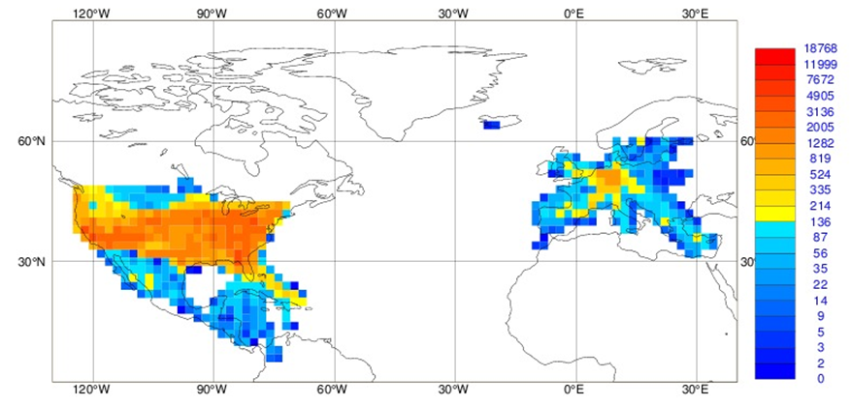
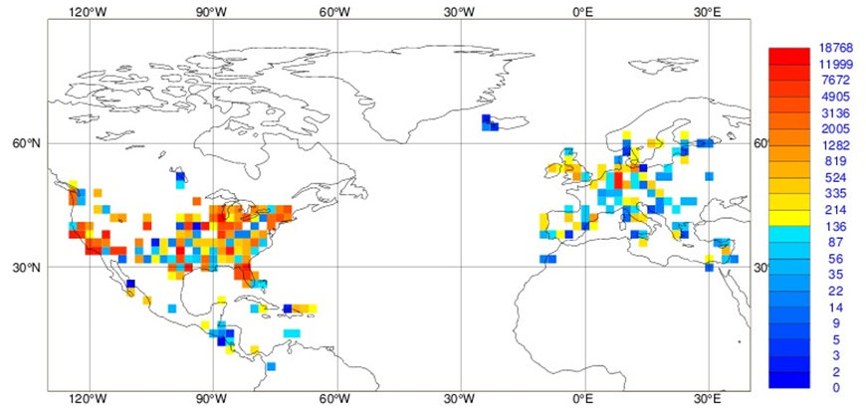
Since March 2016 we have also use aircraft humidity observations
.
Number of Top panel for upper troposphere (above 400 hPa).
Bottom panel for lower troposphere (below 700 hPa).

Slide 13
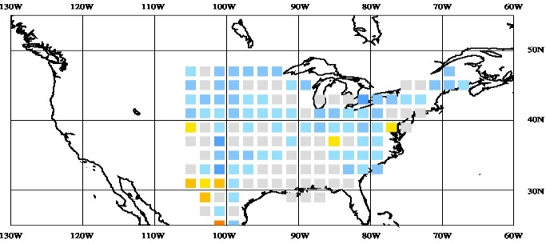
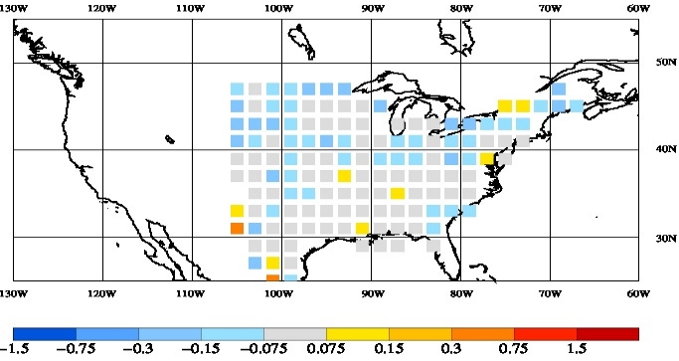
AMDAR humidity data impact study
12 hour fit to rain radar improves
Mean difference for control (top)
AMDAR (below) gives improved mean fit to NEXRAD precipitation (AMJ 2014)
Also slightly more NEXRAD reports pass quality control
Plots and statistics: P Lopez (ECMWF)
Mean fit to NEXRAD/SYNOP 6-hour accumulated precipitation fields: normalised departures for 1 April – 30 June 2014. Left control experiment, right trial experiment using aircraft humidity observations. The largest improvements (more grey squares indicating little bias) are north of 40°N.

Slide 14
Cycle 43r1 (22 Nov 2016) – Highlights
Correction to up-draught momentum and environment for shallow convection
Adjustment to evapotranspiration (shut down when first soil layer is frozen)
Modify land surface coupling coefficients to reduce diurnal cycle T2m errors
Assimilation of NEXRAD snowfall
Updated observation error covariance matrices for IASI and CrIS
Improved aerosol screening for IR sounders, plus new CrIS channel selection
Slant-path radiative transfer for all clear-sky sounder radiances
Reintroduction of model error forcing in the strato (L1-44)
Increase in the resolution of EDA variance (SES) calculation to TL399
New wavelet noise filter for EDA variances (SES) based on TCo639 EDA’s
New SST perturbations in EDA
Improved screen level assimilation when model height ≠ observation height.
MOD
OBS
DA

Slide 15

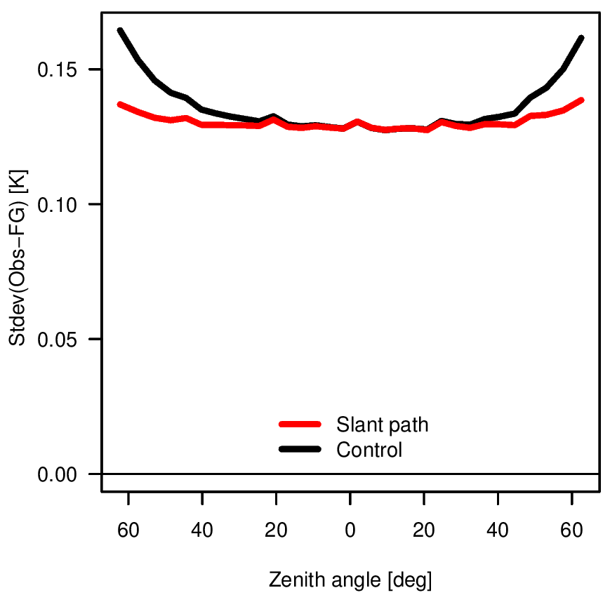
43r1: Slant-path radiative transfer
Effect on departure statistics:
E.g., stdev(Obs-FG), ATMS,
channel 9, by scan-position
Profile previously used in the IFS for radiative transfer calculations
Up to 15 % reduction
Profile used in
slant-path radiative transfer calculations
Zenith
angle

Slide 16
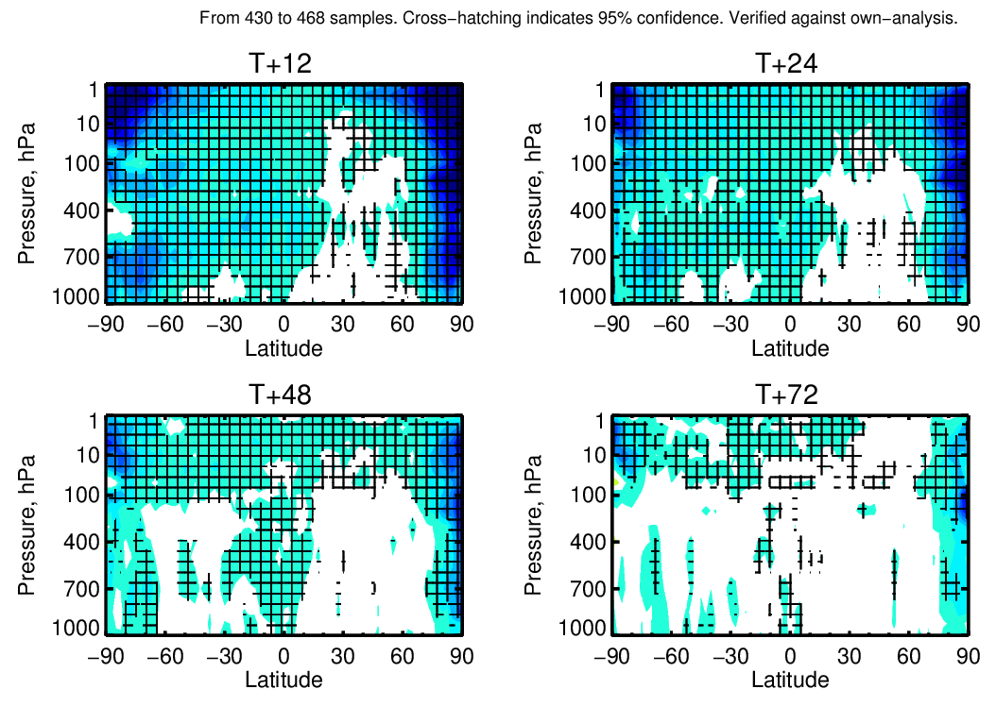
43r1: Forecast impact of slant-path + IASI R changes combined
Normalised difference in RMSE of forecast error,
Vector Wind,
~ 8 months

Slide 17
ECMWF’s 43R3 upgrade (Operational July 2017)
Assimilation
  Improved humidity background error variances directly from the EDA like for all other variables
  Improved tropical cyclone structures via revised wavelet filtering of background error variances and revised quality control of drop-sonde wind observations in 4D-Var
Observations
  Increased use of microwave humidity data by adding SAPHIR and GMI 183 GHz channels
  Activation of 118 GHz channels over land from MWHS-2 instrument on-board FY-3C
  Harmonised data usage over land and sea-ice for microwave sounders
  Improved screening of infrared observations for high concentrations of HCN from wildfires
  Improved quality control for radio occultation observations and radiosonde data
Model
  Glaciation of convective cloud occurs down to colder temperatures (down to -38°C)
  Faster radiation scheme with reduced noise and more accurate longwave radiation transfer
  New aerosol climatology based on CAMS aerosol re-analysis including dependence on RH
  Visibility calculation consistent with new aerosol climatology

Slide 18
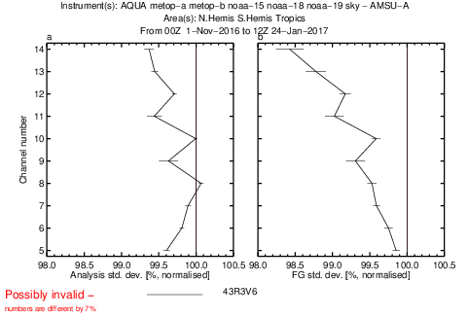
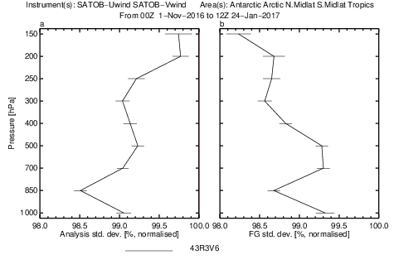
Humidity background error variances from EDA
Use background error variances from EDA instead of current errors which is a regression model
of errors as a function of background RH and model level. Now consistent with other variables.
This improves forecast fit to humidity-sensitive observations and reduces wind vector forecast errors
Also extend humidity-temperature balance to supersaturated regions (wrt mixed phase)
New climatological B matrix from almost a year of latest 43R1 EDA samples.
This improves in particular forecast fit to stratospheric AMSU-A channels
stratopause
100 hPa
Normalized O-B
AMSU-A radiances
Global
20161101-20170124
Normalized O-B
SATOB winds
Global
20161101-20170124
tropopause
1000 hPa

Slide 19
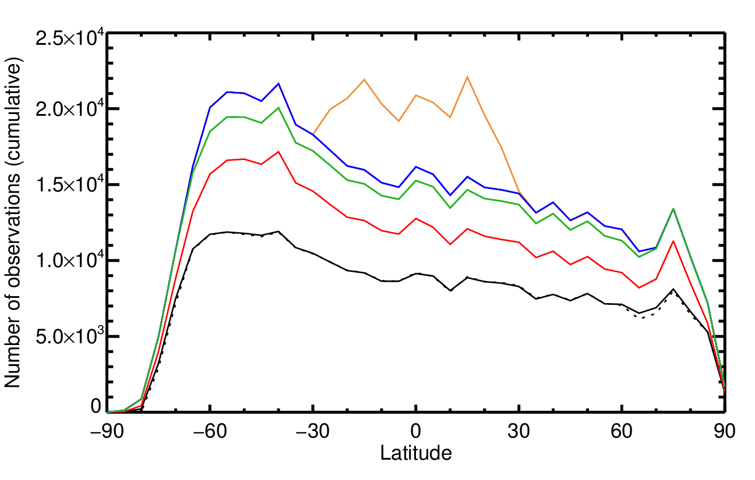
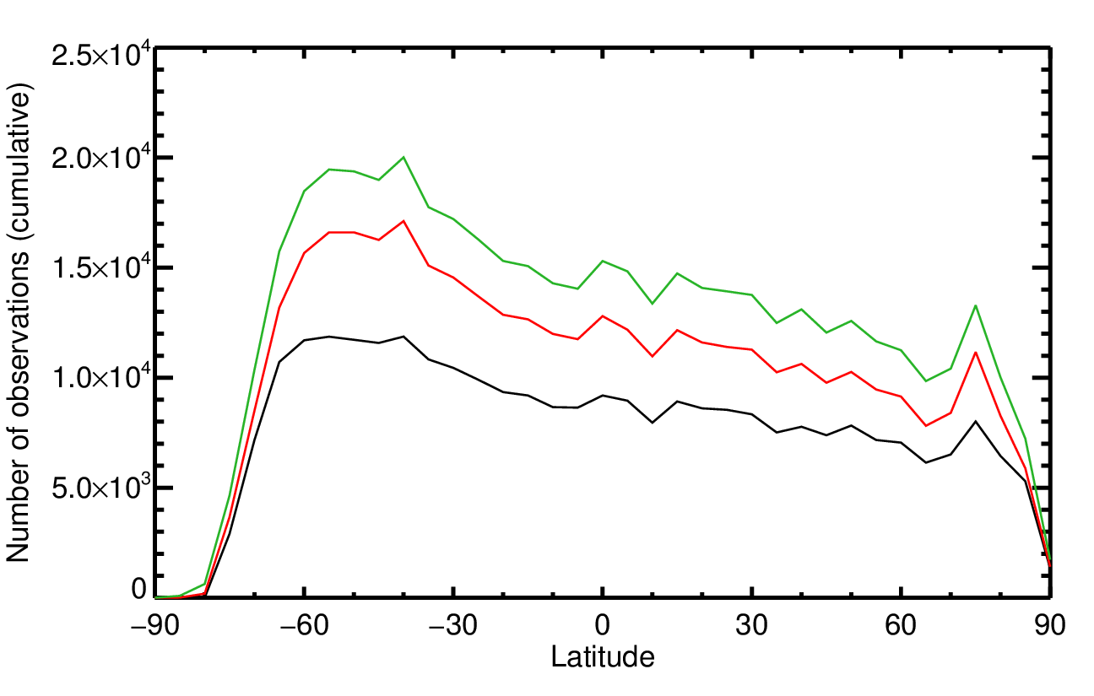
Additional all-sky humidity sounding observations
Daily observation numbers, per 5° bin, in nearest channel to 183±3 GHz
Cy 43r3 (July 2017)
Cy 43r1 (oper. now)
New: SAPHIR
MWHS2
SSMIS (2 sats.)
New: GMI
MHS (4 sats.)
Microwave package also includes:
15% more clear-sky ATMS observations in near-surface channels, activated over sea-ice and cold seas
MWHS2 118 GHz (cloud/temperature channels) activated over land

Slide 20
New aerosol climatology based on CAMS
Optical properties much more sophisticated, especially in longwave
Includes aerosol swelling with humidity; also feeds through to visibility
Aerosol absorption optical depth
  Reducing column absorption over Arabia improves Indian Summer Monsoon
  Excessive biomass burning in CAMS in Central Africa led to erroneous warming of 0.5-1 K at 850 hPa and a degradation of scores - fixed by reducing the absorbing aerosol amount manually

Slide 21
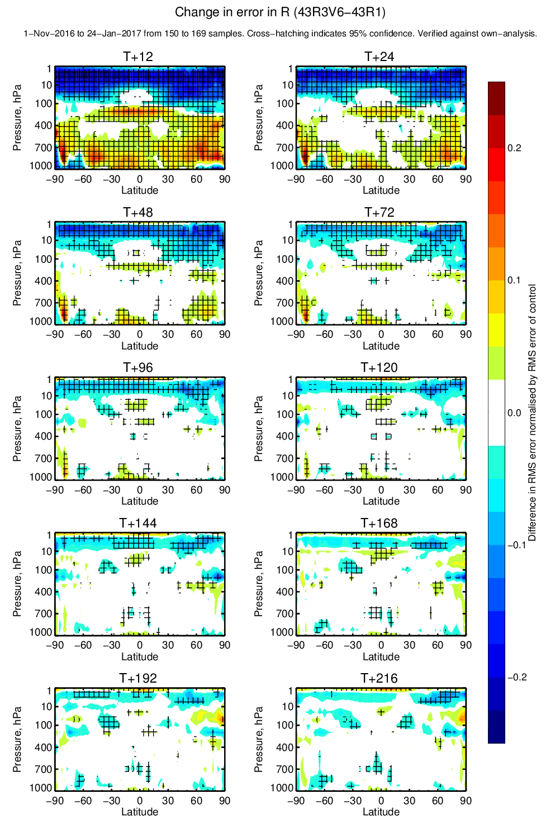
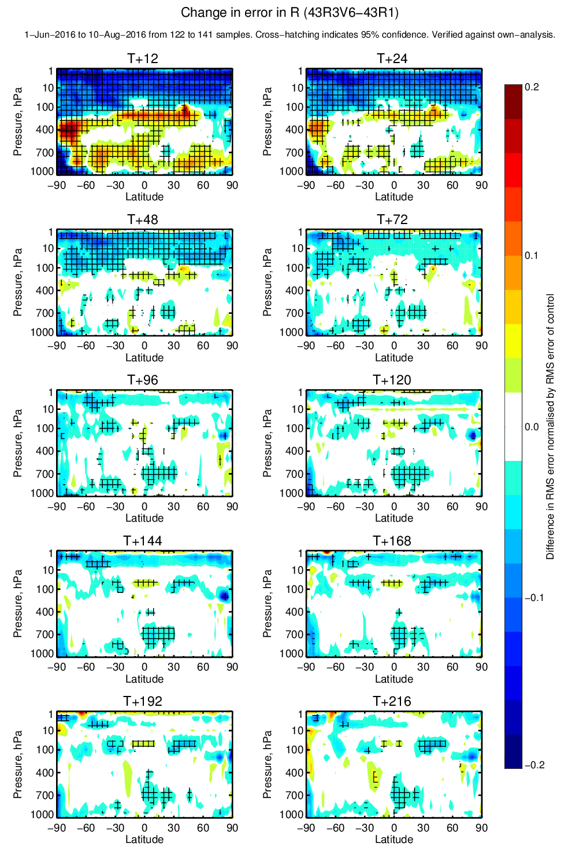
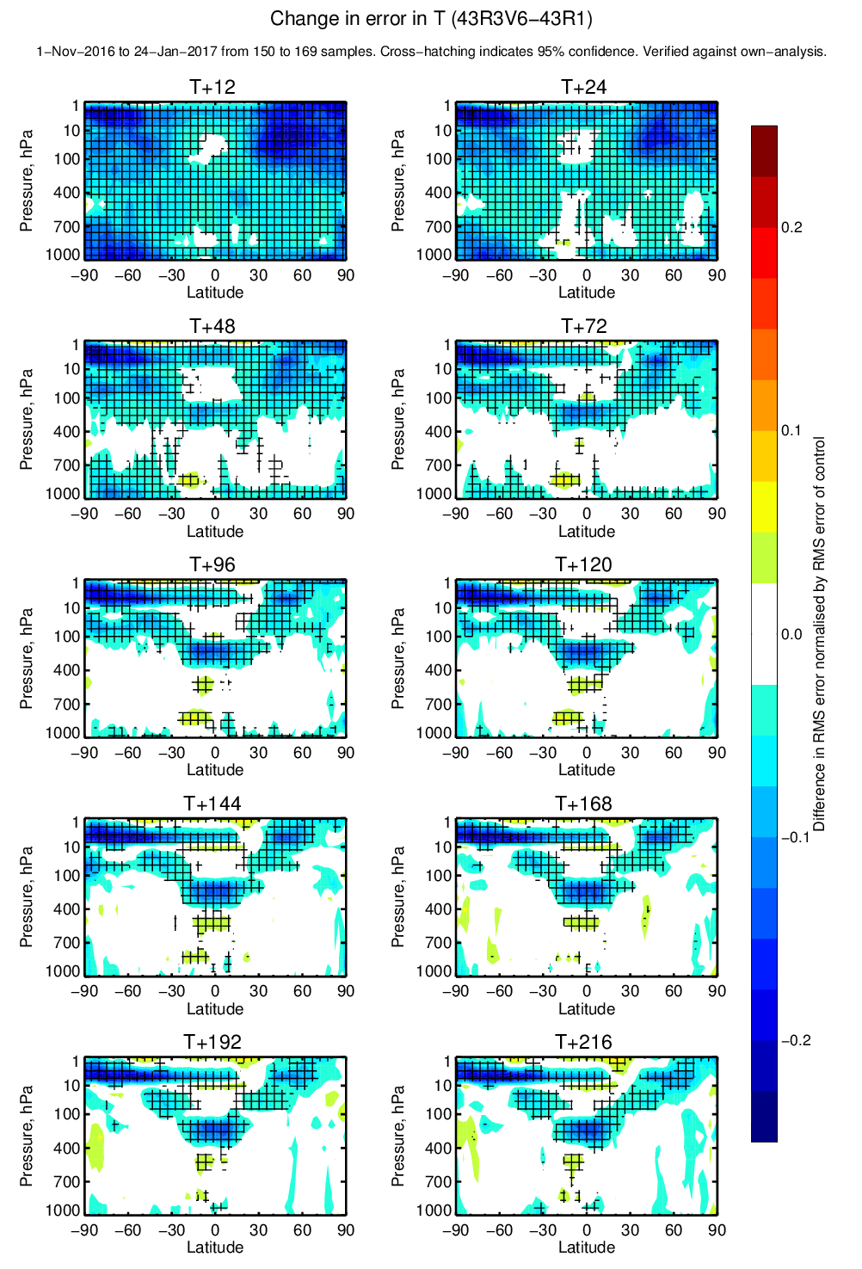
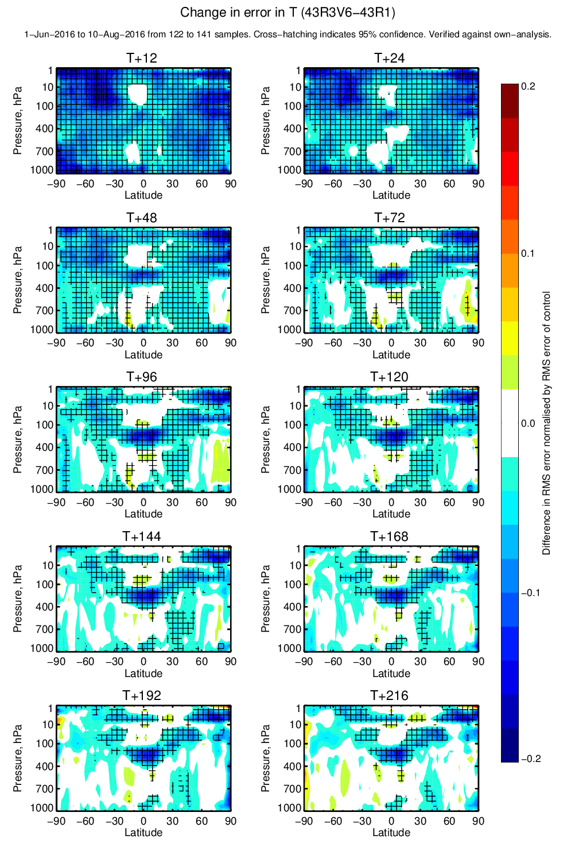
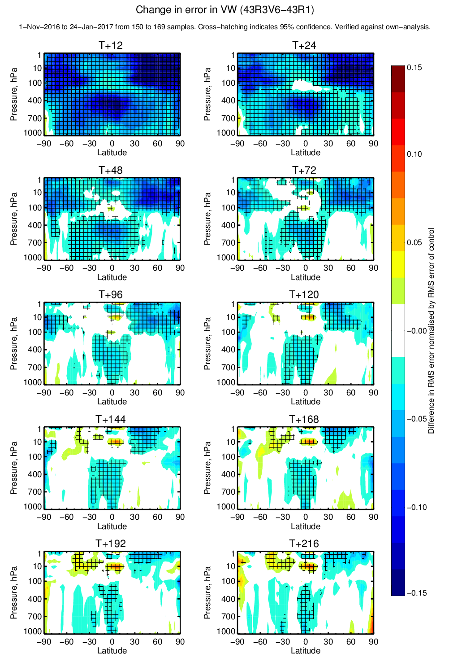
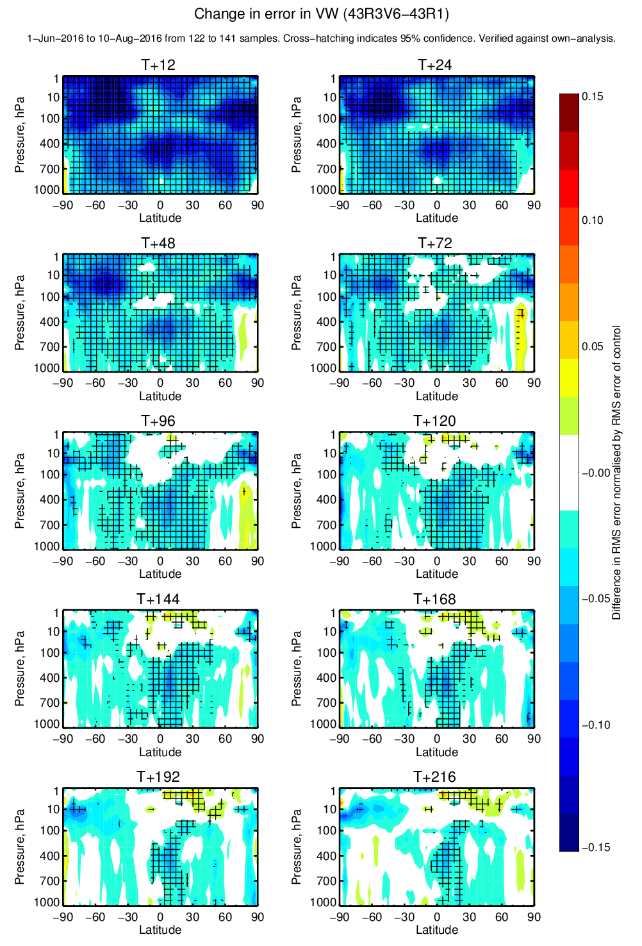
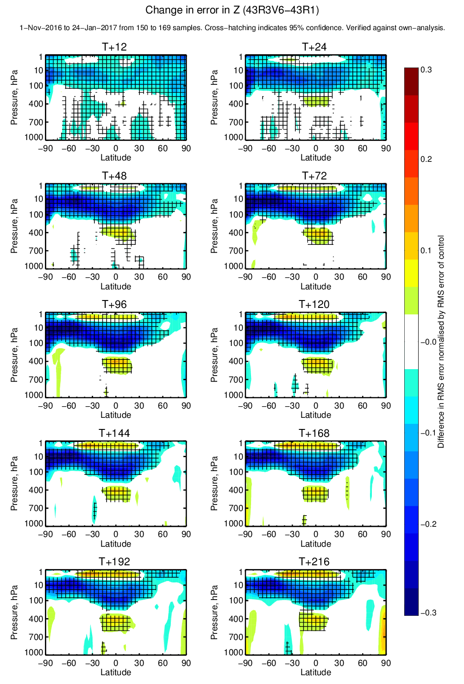
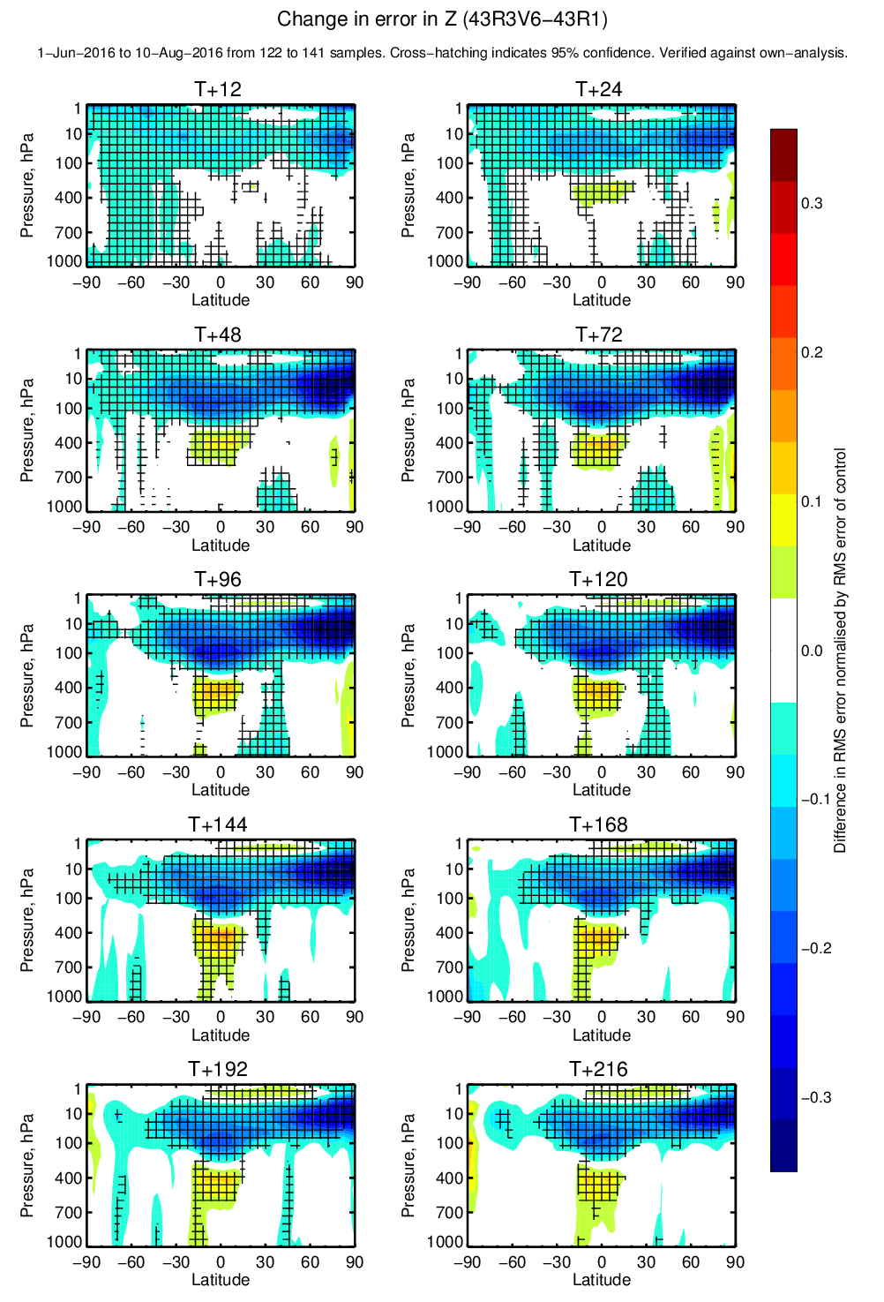
5-day forecast RMSE change: 43r1 → 43r3
Tco1279 RD e-suite
NH Winter
NH Summer
Relative humidity
Temperature
Vector wind
Geopotential height
Blue =
Improvements
Yellow =
degredations

Slide 22
May 2017: Tropospheric GRAS Radio Occultation impact
EUMETSAT GRAS processing changed to wave optics (WO) in November, 2016. WO approach has better bias characteristics in the troposphere, similar to other GPS-RO missions.
This allows us to test assimilating data down to the surface.
  Currently (CY43R1) blacklist below 8 km NH/SH , 10 km in the tropics.
Experiment. November 5, 2016 – Feb 14, 2017 (~100 days).
GRAS experiment assimilated data to the surface versus current operational usage.
Verification against operations shown here.

Slide 23
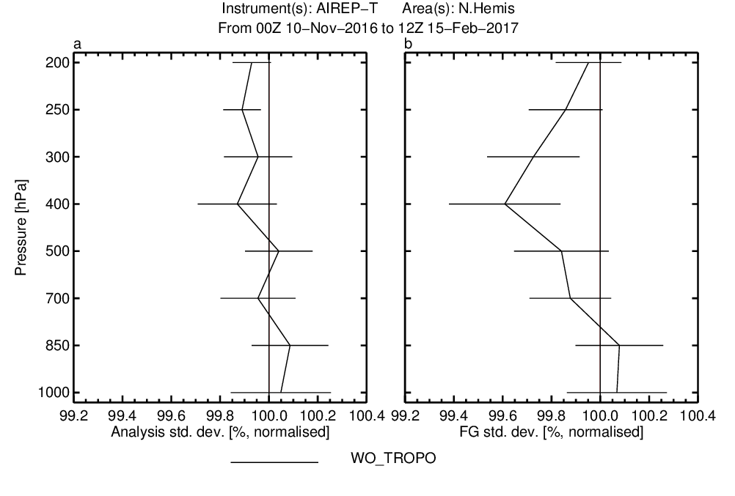
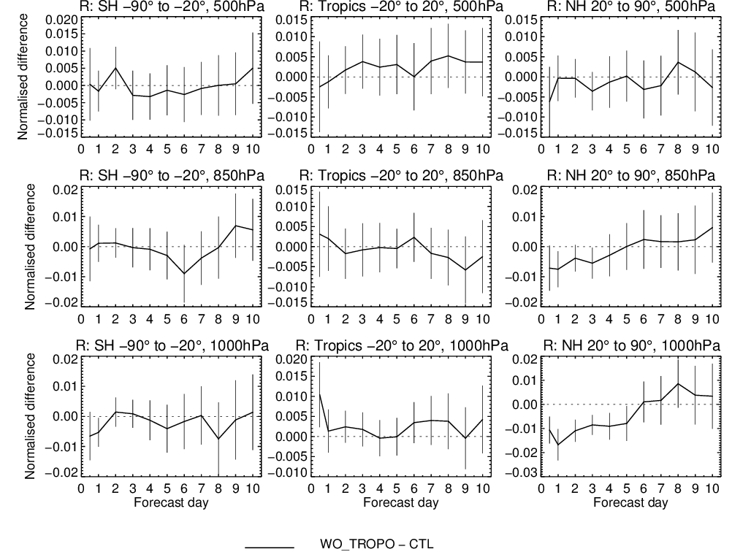
Improved (o-b) fit for aircraft temperatures: NH
May 2017:Tropospheric GRAS Radio Occultation impact
Relative humidity error statistics (change in st.dev)
0
Better
Also improved fit to many other in situ observations in the troposphere

Slide 24
All sky assimilation

Slide 25
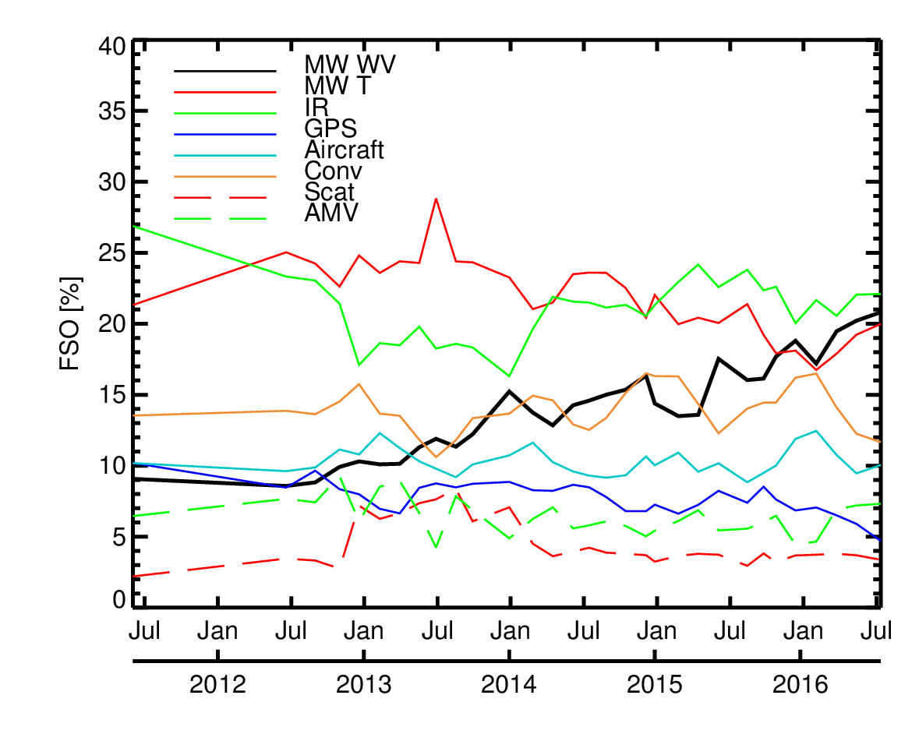
Observation changes: the rise of all-sky!
All-sky assimilation of humidity sounding channels on SSMIS
GMI and AMSR-2 added in all-sky
Growing importance of microwave humidity observations (MHS, ATMS, MWHS-2, SSMIS, AMSR2, GMI, SAPHIR).
Extending this to infrared water vapour information.
Revisiting all-sky microwave temperature observations.
Also investigating radar, lidar, and possible lightning observations (EarthCARE, Aeolus, GOES-R, MTG).
F18, all-sky over snow, MWHS-2
ATMS and Metop-B MHS added in clear skies
All-sky assimilation of all four MHS (transferred from clear-sky)

Slide 26
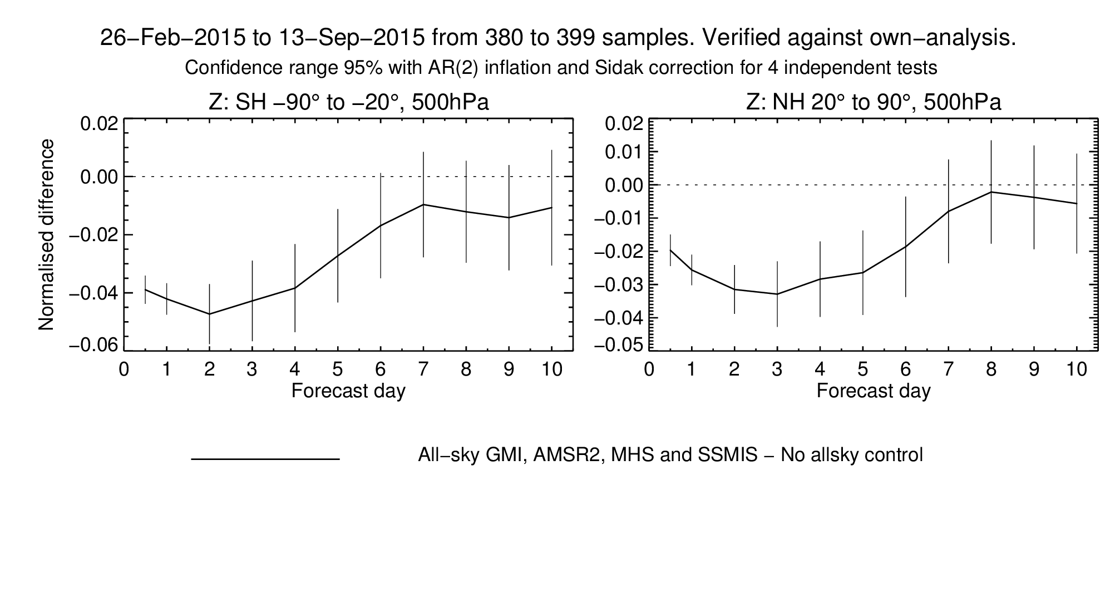
Observation changes: the rise of all-sky!
Mechanism: 4D-Var can infer dynamical initial conditions from observed WV, cloud and precipitation

Slide 27
Conclusions (all-sky impact)
Microwave water vapour observations are currently the “number 1” observing system by FSO:
  Water vapour, cloud and precipitation observations now provide significant real benefits, equivalent to traditional clear-sky temperature sounding.
    4D-Var “tracing” (including adjoint of moist physics)
    All-sky assimilation
    Broad coverage (ocean, land, snow-covered land, sea-ice)
    Wealth of microwave imagers and sounders currently available
    Supported by general improvements in DA and model
Can we get even more benefit? e.g. 43r3 developments:
  Add GMI humidity channels, retune MHS observation error over land
  MHS / ATMS channel harmonisation (Pete Weston)
  Actively assimilate SAPHIR, equivalent to 2-3 MHS in the tropics (added on top of 11 existing microwave humidity instruments)

Slide 28
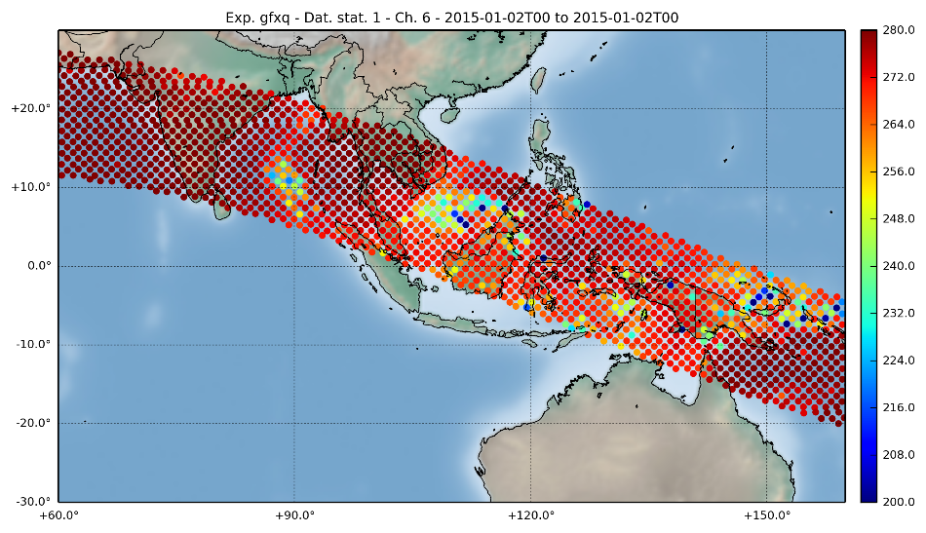
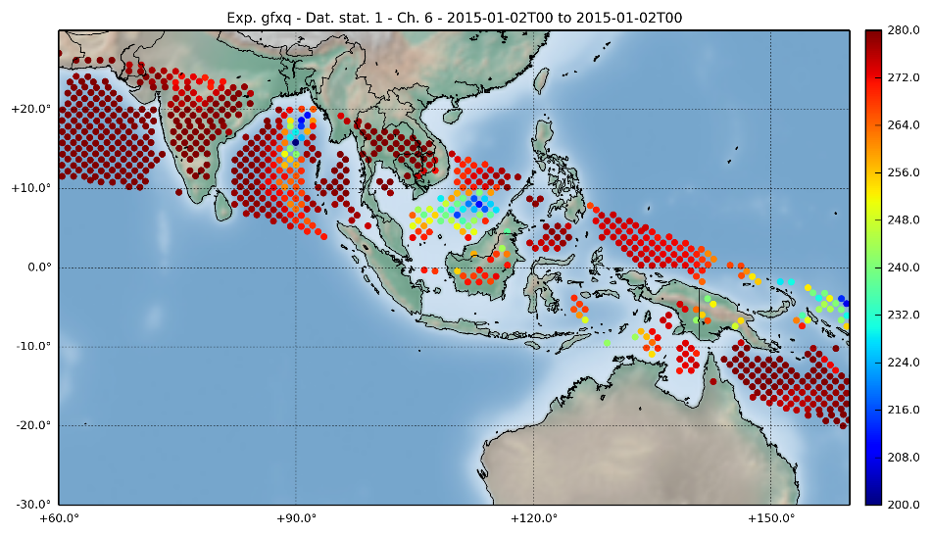
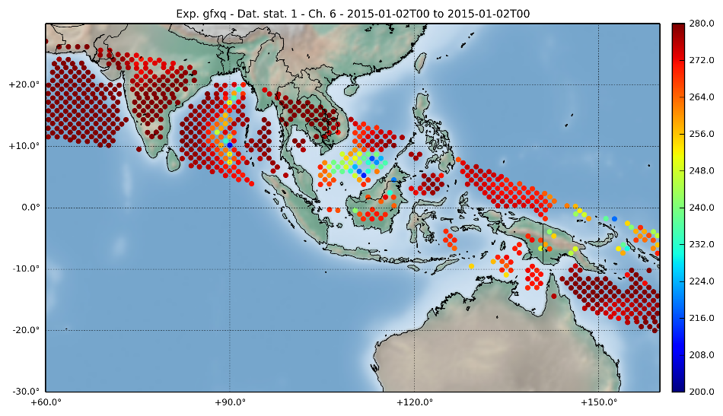
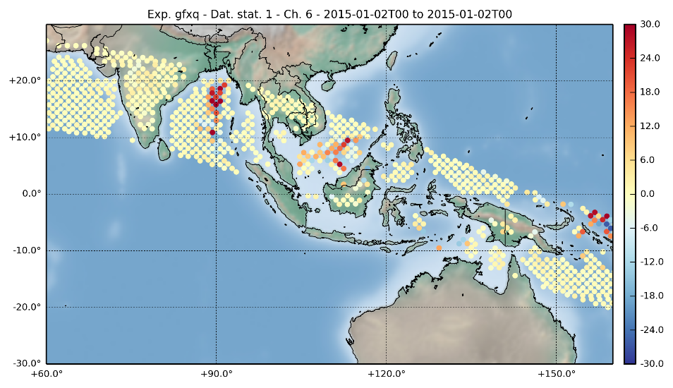
SAPHIR – tropical sensor with multiple overpasses per day
Philippe Chambon (visiting from Meteo France) and Alan Geer (ECMWF)
Observations
[K]
First guess
[K]
Analysis
[K]
Reduction in absolute departure

Slide 29
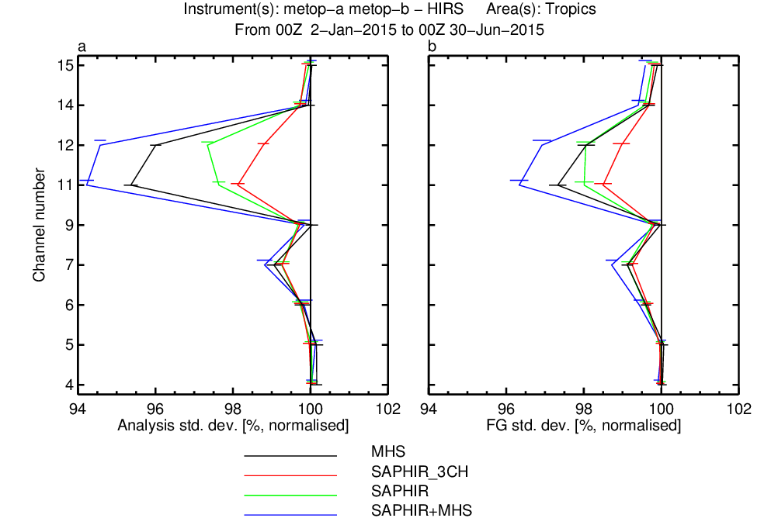
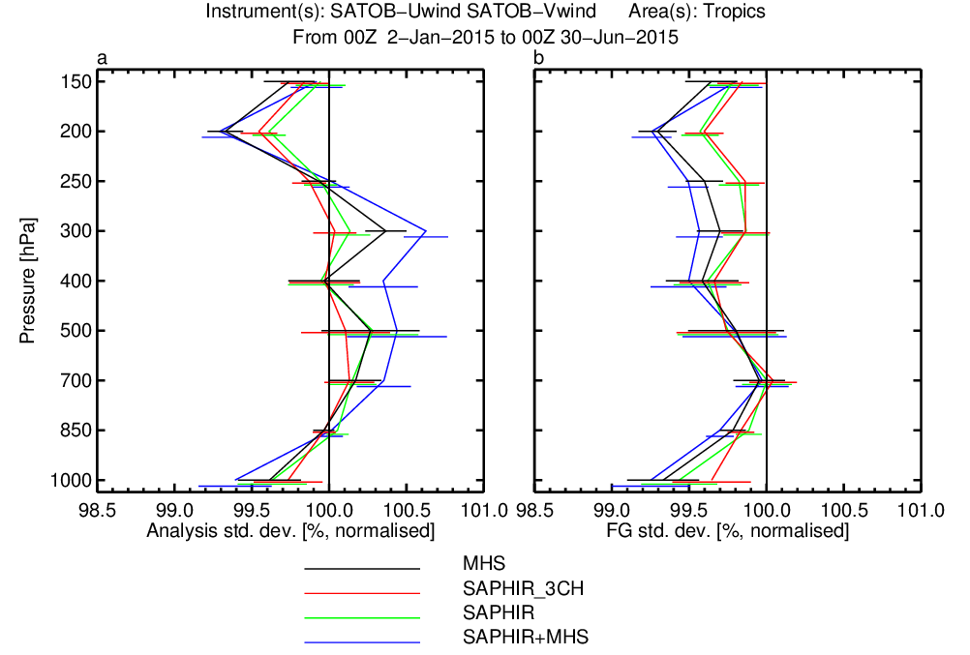
Tropical obstats: FG standard deviations baseline: 7 microwave WV instruments + rest of global observing system add: 4 MHS or 1 SAPHIR, or 4 MHS and SAPHIR
HIRS (water vapour)
SATOB (winds)
SAPHIR impact approaches that of the 4 MHS sounders in the tropics
SAPHIR adds information even on top of 11 existing sensors

Slide 30
Some plans for 2018
RTTOVS-12
Improved aircraft bias corrections
Accounting for radiosonde drift of BUFR radiosondes
Assimilate FY-3 GPS-RO
ADM-Aeolus
And a few more examples on the next pages.

Slide 31
Improving 4D-Var: Overlapping windows
Will try to make this invisible to users.
Targeting e-suite later in 2017 with view to operational change spring 2018.
09
12
15
18
21
00
03
06
09
12
15
18
21
00
03
LWDA
Current
DA
X_b=X_fg
FC
LWDA=12h 4D-Var
DA=6h 4D-Var
LWDA
DA
Currently complex operational suite.
Not readily extendable to longer windows.
The proposed framework does not introduce correlations between background and observation errors.
Framework for increasing the assimilation window length, and “quasi-continuous” DA.
FC
X_b=X_fg
LWDA
Future
LWDA
LWDA=12h 4D-Var
FC
LWDA
FC
X_b
X_fg
LWDA
FC

Slide 32
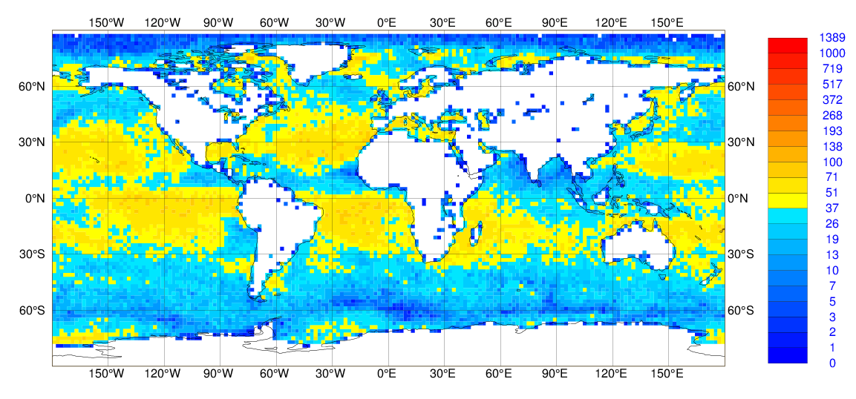
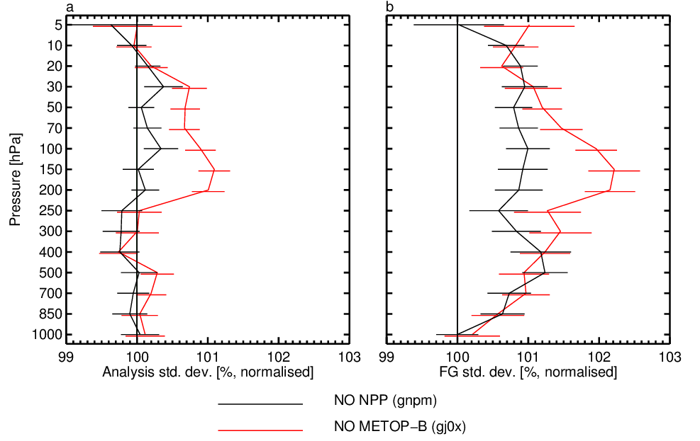
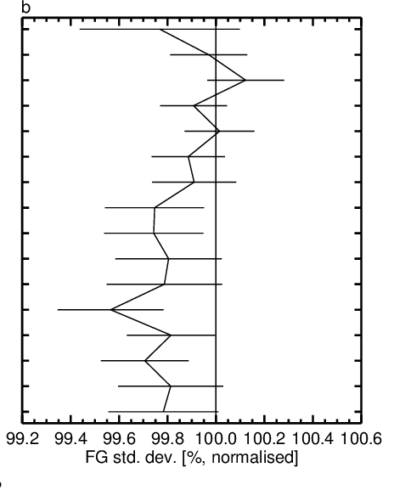
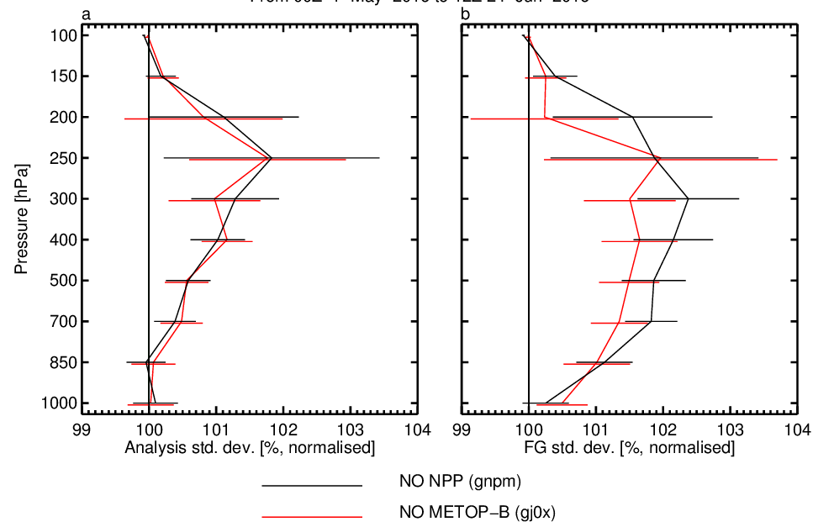
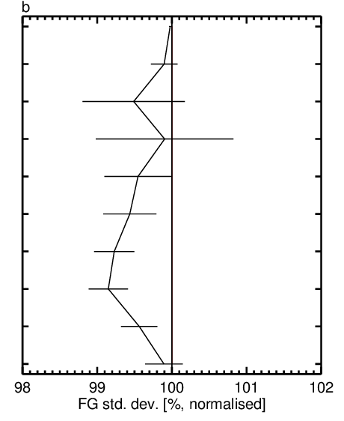
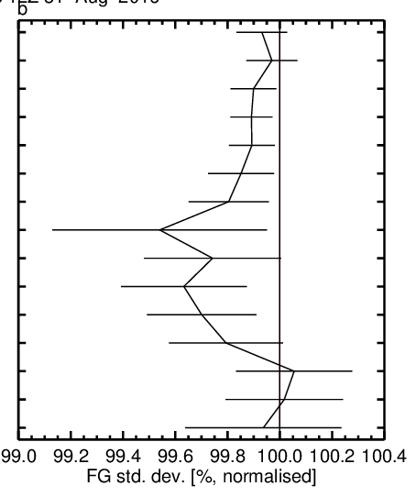


Assimilating IR spectra over land surfaces
Improved cloud detection over land has allowed hyperspectral IR (e.g. IASI) to be assimilated the same way it is used over ocean.
TEMP-VW
TEMP-T
TEMP-Q
Using IR data over land produces a significant positive impact on the analysis and forecasts
Note this impact is on top of extensive MW data use over land!
(Reima Eresmaa,NWP-SAF)

Slide 33



All sky sounding channels over coasts
All sky MW channels are currently rejected over coasts (0.01<lsm<0.95)
Over land (lsm>0.95) a dynamic emissivity retrieval is used to assimilate MW sounding channels (118 & 183GHz) and this can be extended to coastal areas
Departure statistics in coastal regions is similar to elsewhere
Experiments with added data over coasts show improved fits to humidity sensitive and wind observations.

Slide 34



Conventional data, current priorities
BUFR observations of snow depth
  New specific WMO template available
Improved reporting by adopting BUFR
  High-resolution radiosonde profiles
  Time and position of all data in the ascent
  Better handling of meta-data, included in the message
Hourly surface observations
Improved coverage
  Complement sparse WMO/GTS reporting with regional or national data
Improved maintenance of the WMO station list, and accuracy of station metadata

Slide 35
Summary
ECMWF still making progress in NWP, primarily through improved use of observations in the data assimilation system.
There are still issues with observation, as there always will be
Collaborations like GODEX are very beneficial for the NWP community
Part 2 of ECMWF status report this afternoon:
BUFR migration, timeliness and snow data issues – Ioannis Mallas

